Slide 1
Chapter 1:
Introduction to Security Operations Centres

Slide 2
Objectives
After studying this chapter, you should be able to
  Define SOC as a centralized entity for security management.
  Emphasize the primary mission of safeguarding organizational assets.
  Highlight the need for ongoing SOC evaluation in evolving business environments.
  Discuss adaptation necessities during acquisitions or leadership changes.
  Explain security's role in project justification.

Slide 3
Understanding SOC
Definition and Purpose:
A Security Operations Center (SOC) is a centralized unit, staffed either by an organization's own personnel or by a third-party managed security service provider. It is responsible for continuously monitoring, detecting, analyzing, and responding to cybersecurity threats across an organization's IT infrastructure [1].
Core Functions:
Threat Detection and Prevention: SOCs actively watch networks, systems, and applications for suspicious activity, aiming to catch threats before they escalate into full breaches [2].
Rapid Incident Response: SOCs follow established procedures to contain and remediate breaches once detected, limiting damage to operations and data integrity [2].
Continuous Monitoring: Round-the-clock coverage ensures incidents are caught even outside normal business hours, given how quickly modern attacks move [3].

Slide 4
Understanding SOC
Risk Management: By identifying vulnerabilities proactively and prioritizing fixes using real-time threat intelligence, SOCs help organizations manage risk rather than just react to it [1].​
Compliance: SOCs help organizations meet regulatory monitoring and incident-response requirements (e.g., GDPR, HIPAA, PCI-DSS), reducing exposure to fines and legal consequences [3].​
Protection of Assets and Reputation: Effective SOC operations safeguard sensitive data and intellectual property, which in turn protects customer trust [1].​

Slide 5
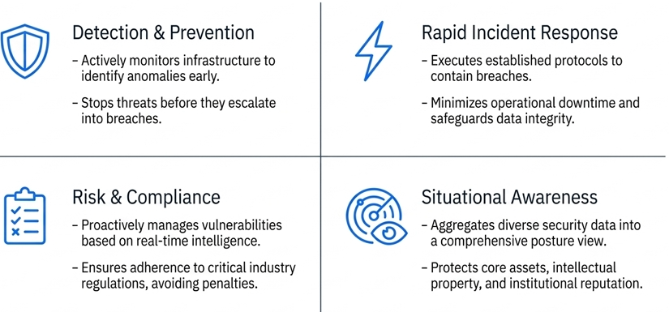
Understanding SOC
Why Technology Alone Is Not Enough
A SOC's technology stack (SIEM, IDS/IPS, EDR) is only as effective as the people and processes built around it. When a correctly generated alert is not escalated and acted on with urgency, the detection layer can perform exactly as designed and the organization can still suffer a major breach [4].

Slide 6
Case Scenario
Target Corporation, 2013 Target had installed a $1.6 million FireEye malware-detection system weeks before the breach, paired with a monitoring team in Bangalore reporting to a security operations center in Minneapolis [4]. On November 30 and again on December 2, 2013, FireEye correctly identified the exfiltration malware and issued high-severity alerts; the Bangalore team escalated the alerts to Minneapolis, but on both occasions the warnings went unheeded [5]. Analysts in Minneapolis reviewed the alert, classified it as a false positive, and dismissed it — a failure widely attributed to alert fatigue from the sheer daily volume of low-level warnings SOC teams typically face [6]. The result was the theft of approximately 40 million credit card numbers and 70 million customer records [5]. This case is a standard illustration in SOC training of how strong detection technology cannot compensate for weak triage process and escalation discipline.

Slide 7
SOC Objectives
Overview
The objectives of a SOC define what the unit is ultimately trying to achieve for the organization [1]:
  Identify potential threats early to prevent escalation into full incidents.
  Ensure quick and effective response to security incidents once they occur.
  Reduce the impact of security incidents on business operations.
  Safeguard the organization's data, systems, and networks from unauthorized access or compromise.
  Ensure adherence to industry, national, and global privacy regulations, avoiding legal and financial exposure.

Slide 8
SOC Objectives
Why Objectives Matter More Than Tools?
These objectives give a SOC its measure of success. A SOC can be fully staffed and equipped with modern SIEM, IDS/IPS, and EDR platforms and still fail to meet its core objectives if alerts are not escalated with urgency or if incident response procedures break down under pressure [6]. In other words, the objectives are the standard against which a SOC's people, process, and technology should be evaluated — not simply whether the tools exist, but whether threats are actually caught early and impact is actually minimized.

Slide 9
Case Scenario
Target Corporation, 2013
Target's SOC objectives were only partly met. The objective of early threat identification was technically achieved: FireEye correctly flagged the exfiltration malware on November 30 and again on December 2, 2013 [4]. However, the objective of ensuring a quick and effective response failed — the alerts were reviewed and dismissed rather than acted on. As a direct consequence, the objective of reducing impact on operations also failed: the breach ultimately affected roughly 40 million credit and debit card accounts between November 27 and December 15, 2013 [5]. The objective of safeguarding data was not met, and the fallout — including congressional scrutiny, regulatory attention, and dozens of lawsuits — illustrates how a shortfall against just one objective (timely response) can cascade into failure against all the others.

Slide 10
Discussion
Walk through each of the five SOC objectives above and identify, for the Target case, which were met, which were not, and at what point in the incident timeline the failure occurred.

Slide 11
Components of a SOC :
People- Process- Technology

Slide 12
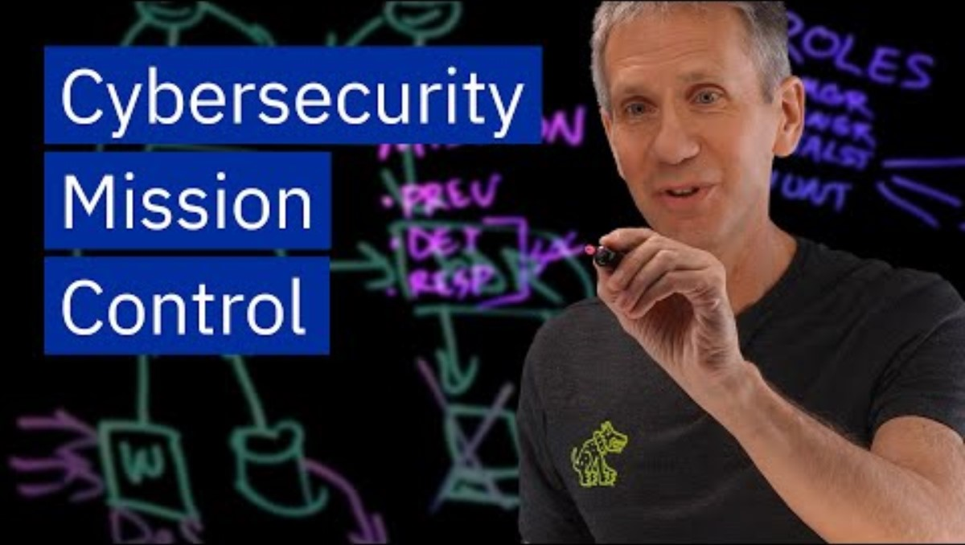
SOC in Cybersecurity

Slide 13
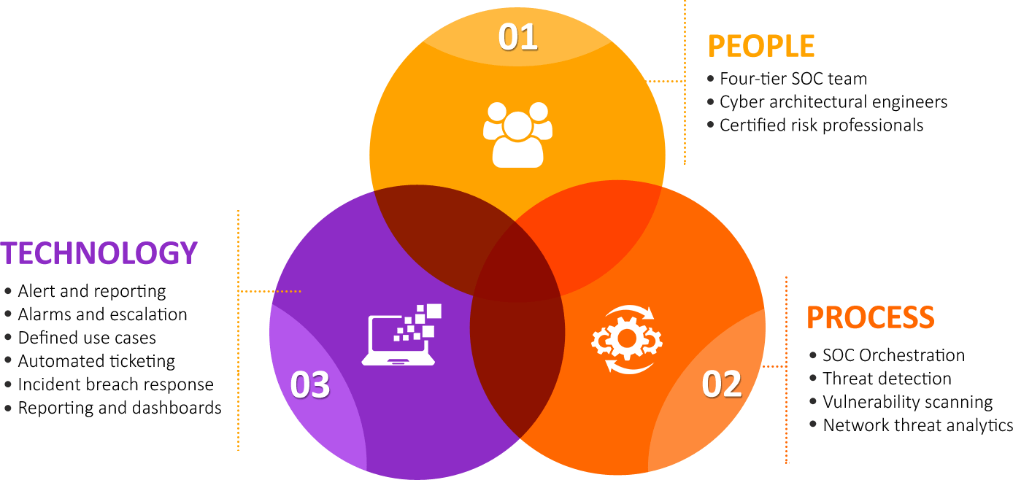
Components of SOC

Slide 14
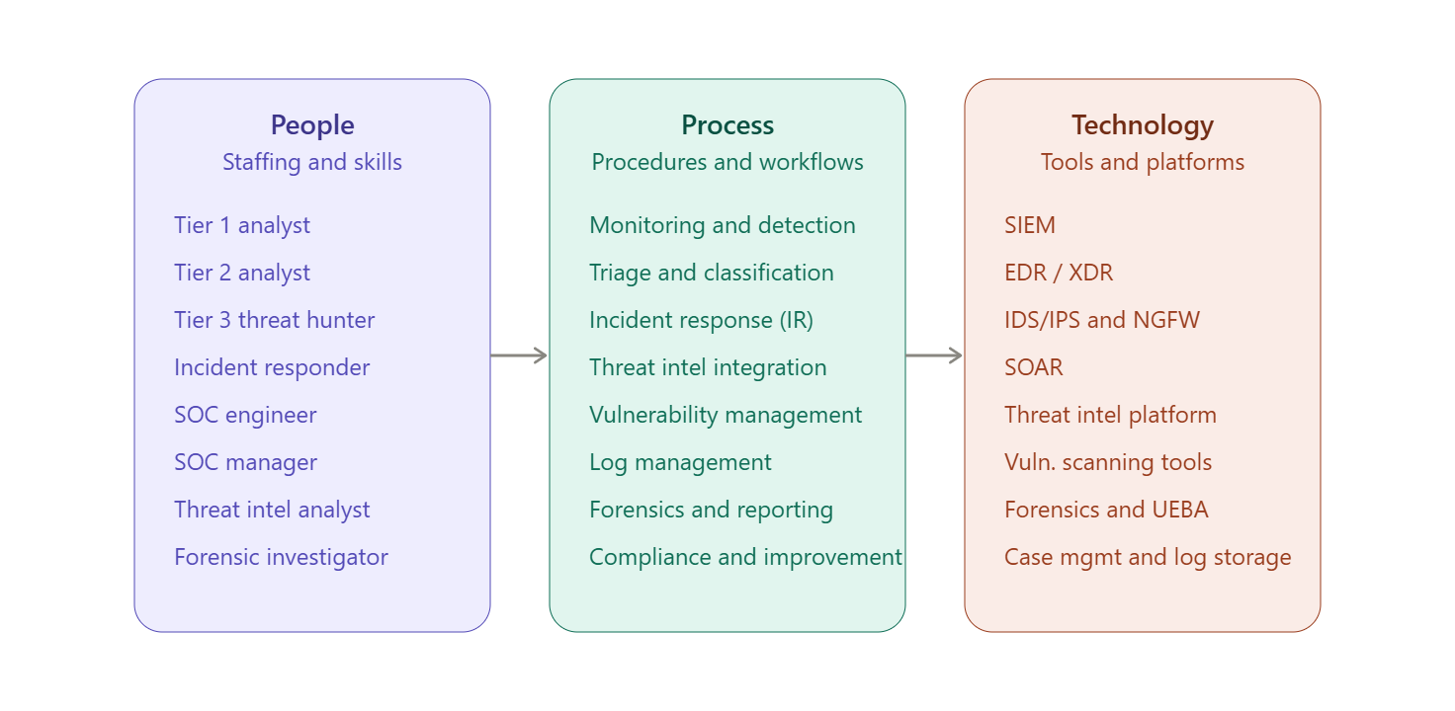
Components of SOC
A SOC's effectiveness rests on three interdependent components — people, process, and technology [1]. Strength in one area cannot fully compensate for weakness in another: skilled analysts without defined procedures improvise inconsistently, and the best tools generate value only when someone acts on what they report.

Slide 15
Components of SOC: People
Role | Primary Focus | Key Duties
SOC Analyst – Tier 1 | Initial detection (frontline) | Monitor SIEM tools; analyze alerts for urgency; perform initial triage to eliminate false positives; escalate to Tier 2 when needed
SOC Analyst – Tier 2 | Incident response / deeper analysis | Investigate escalated incidents to confirm genuine threats; conduct root cause analysis; propose or apply mitigation; liaise with IT/development teams
SOC Analyst – Tier 3 | Threat hunting | Proactively hunt for anomalies that don't trigger standard alerts; develop custom detection rules; stay current on emerging threats; deep-dive investigations
Incident Responder | Active incident handling | Contain and mitigate breaches; collaborate to isolate compromised systems; collect forensic data; guide recovery and restoration

Slide 16
Components of SOC: People
Role | Primary Focus | Key Duties
SOC Engineer | Infrastructure and tooling | Manage SIEM/firewalls/IDS-IPS/endpoint protection; ensure monitoring system reliability and scalability; integrate new data sources; help build playbooks
SOC Manager | Team leadership and strategy | Develop security policies and IR playbooks; coordinate team efforts and prioritize responses; set strategic direction; report to upper management
Threat Intelligence Analyst | External threat awareness | Collect and disseminate threat intel to the team; identify relevant vulnerabilities/risks; correlate global threats with internal incidents; maintain intel-sharing relationships
Forensic Investigator | Post-incident investigation | Perform in-depth analysis of compromised systems; preserve and document evidence for legal proceedings; work with legal/law enforcement; produce post-mortem reports
Compliance Officer / Auditor | Regulatory alignment | Audit SOC procedures and controls; ensure adherence to GDPR/HIPAA/PCI-DSS etc.; recommend improvements; provide audit reports to regulators

Slide 17
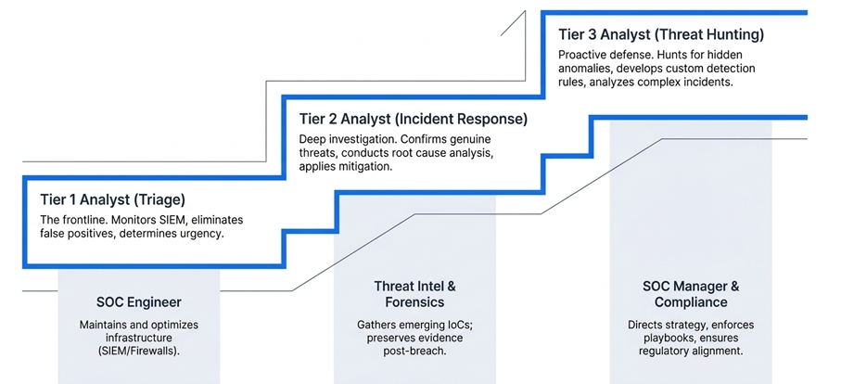
Components of SOC: People

Slide 18
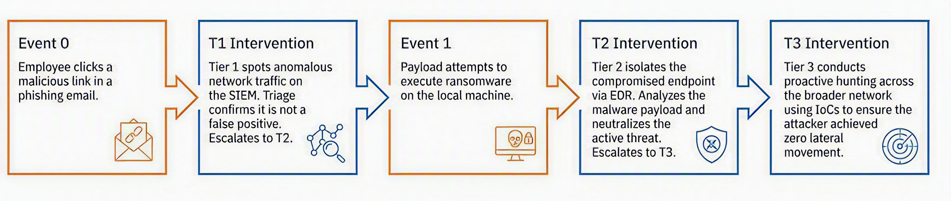
Components of SOC: People
Attack escalation: ( phishing to malware)

Slide 19
Discussion
In the Target Corporation (2013) breach, FireEye's alert was correctly generated and escalated by the monitoring team in Bangalore (functioning as Tier 1), but the team in Minneapolis (effectively Tier 2) reviewed it, classified it as a false positive, and took no further action.
Based on the role table above: which tier's responsibilities were actually fulfilled, which tier's responsibilities failed, and what specific duty from that role's list should have prevented the alert from being dismissed?

Slide 20
Components of a SOC : Processes
Monitoring & Detection : continuous monitoring of logs, events, and network traffic; correlation of alerts across SIEM, IDS/IPS, firewall, and EDR tools; baseline creation for normal behavior.
Incident Identification & Classification : triage of alerts to separate true positives from false positives, and categorization by type (malware, phishing, insider threat, DDoS, etc.).
Incident Response : following a structured framework such as NIST's PICERL model (Preparation, Identification, Containment, Eradication, Recovery, Lessons Learned), supported by playbooks and runbooks for common attack types.
Threat Intelligence Integration : ingesting threat feeds, indicators of compromise (IoCs), and adversary tactics, techniques, and procedures (TTPs), typically mapped against frameworks like MITRE ATT&CK.

Slide 21
Components of a SOC : Processes
Vulnerability Management: regular scanning and patch management, prioritized by risk and asset criticality.
Log Management: collecting, normalizing, and retaining security logs while preserving log integrity for compliance.
Forensics & Root Cause Analysis|: investigating affected systems to determine attack origin, with evidence preserved for legal or compliance purposes.
Reporting & Communication: producing regular incident and trend reports and maintaining clear channels with IT, management, and external stakeholders.
Compliance & Governance: ensuring operations align with standards such as ISO 27001, GDPR, HIPAA, and PCI-DSS, with documented policies and audit trails.
Continuous Improvement: post-incident reviews that refine detection rules, playbooks, and automation over time.

Slide 22
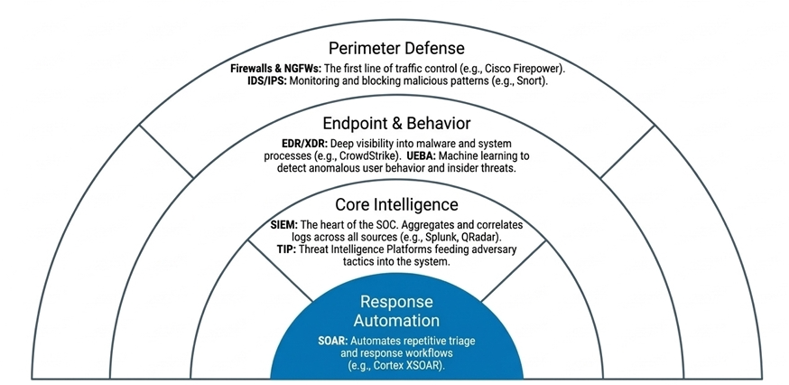
Components of a SOC: Technology

Slide 23
Components of a SOC: Technology
Security Information and Event Management (SIEM)
  Core of SOC operations.
  Collects, aggregates, correlates, and analyzes logs/events from multiple sources.
  Examples: Splunk, IBM QRadar, Elastic SIEM, ArcSight.
Endpoint Detection and Response (EDR) / Extended Detection and Response (XDR)
  Provides deep visibility into endpoint activities.
  Detects malware, ransomware, and suspicious processes.
  Examples: CrowdStrike Falcon, Microsoft Defender for Endpoint, SentinelOne.
Intrusion Detection and Prevention Systems (IDS/IPS)
  IDS: Monitors traffic for malicious patterns.
  IPS: Blocks or prevents detected threats.
  Examples: Snort, Suricata, Cisco Firepower.

Slide 24
Components of a SOC: Technology
Firewalls & Next-Generation Firewalls (NGFWs)
  First line of defense to control incoming/outgoing traffic.
  NGFWs include deep packet inspection, app control, and threat intelligence.
Threat Intelligence Platforms (TIP)
  Aggregates IoCs, threat feeds, and adversary TTPs.
  Supports proactive defense and hunting.
  Examples: MISP, ThreatConnect, Anomali.
Security Orchestration, Automation, and Response (SOAR)
  Automates repetitive SOC tasks like triage, enrichment, and response.
  Integrates with SIEM and other tools.
  Examples: Palo Alto Cortex XSOAR, Splunk SOAR, IBM Resilient.
Vulnerability Assessment & Management Tools
  Identifies and prioritizes vulnerabilities in systems and applications.
  Examples: Nessus, OpenVAS, Qualys.

Slide 25
Components of a SOC: Technology
Forensics Tools
  Used for deep-dive investigation and evidence gathering.
  Examples: FTK, Autopsy, Volatility.
Packet Capture & Network Monitoring Tools
  Provides traffic analysis and anomaly detection.
  Examples: Wireshark, Zeek (Bro), NetFlow analyzers.
User and Entity Behavior Analytics (UEBA)
  Uses machine learning to detect anomalies in user and system behavior.
  Helps identify insider threats and compromised accounts.
Cloud Security Monitoring Tools
  Ensures visibility and compliance in cloud environments.
  Examples: AWS GuardDuty, Azure Security Center, Prisma Cloud.
Case Management / Ticketing Systems
  Tracks incidents, investigations, and response workflows.
  Examples: ServiceNow, JIRA, TheHive.
Data Lakes / Log Storage
  Scalable storage for long-term data retention, compliance, and hunting.
  Examples: ElasticSearch, Hadoop-based storage.

Slide 26
Case Scenario
Equifax, 2017
The Equifax breach illustrates all three components failing in combination rather than any single one. Technology: a critical flaw in the open-source Apache Struts framework (CVE-2017-5638) went unpatched on Equifax's systems; a vulnerability scan run on March 15, 2017 — specifically intended to catch exactly this kind of exposure — failed to detect the affected systems [7]. Process: company policy required patching within 48 hours of a critical alert, but the vulnerability, disclosed by US-CERT and DHS on March 8, remained unpatched for months [7], [8]. People: the internal notification to patch went out on March 9, but the employee responsible for the affected system reportedly never received it because a manager failed to forward it, and a later congressional report noted that senior executives skipped briefings on the issue [8]. The result was exposure of personal data for 143 million people. Because the failure touched people, process, and technology simultaneously, this case works well as a single example spanning all three components at once, rather than needing three separate case studies.

Slide 27
Discussion
For the Equifax case, identify one corrective control from the People component, one from Process, and one from Technology that — had it worked as intended — would independently have prevented the breach

Slide 28
SOC Configurations

Slide 29
Types of SOC Configurations
Security Operations Centers (SOCs) can be configured in various ways to suit the needs and resources of different organizations. Here are some common types of SOC configurations:
In-House SOC(dedicated) : Operated directly by the organization with full-time staff.
Managed SOC (M-SOC): Security monitoring outsourced to a third-party provider.
Hybrid SOC: Combines in-house and managed SOC elements for flexibility.
Virtual SOC (V-SOC): Operates remotely using cloud-based tools and technologies.
Co-managed SOC: Organization shares SOC operations with a managed security services provider.
These configurations offer varying levels of control, cost, and scalability, allowing organizations to choose the best fit for their needs.

Slide 30
Types of SOC Configurations
Configuration | Who Operates It | Best Suited For | Trade-off
In-house SOC (dedicated) | Full-time staff employed directly by the organization | Large organizations needing maximum control and customization | Highest cost — significant investment in infrastructure, personnel, and maintenance
Managed SOC (M-SOC) | Third-party managed security service provider (MSSP) | Organizations lacking resources/expertise to build their own SOC | Less direct control; relies on the MSSP's tools and staff
Hybrid SOC | Split — some functions in-house, some outsourced | Organizations wanting flexibility (e.g., in-house IR, outsourced monitoring) | Requires clear division of responsibility to avoid coordination gaps
Virtual SOC (V-SOC) | Analysts working remotely via cloud-based tools | Distributed workforces or cloud-first organizations | Depends heavily on reliable connectivity and cloud tooling
Co-managed SOC | Shared responsibility between organization and MSSP | Organizations needing close MSSP collaboration for compliance reasons | Requires strong coordination to prevent duplicated or missed coverage

Slide 31
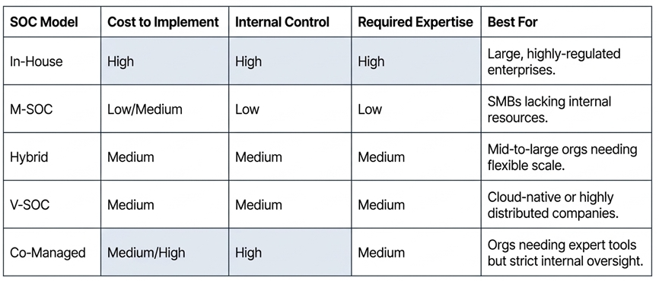
Types of SOC Configurations
Choosing a Configuration
No single configuration is universally superior; the right choice depends on organizational size, cost tolerance, asset criticality, and specific compliance obligations [1].

Slide 32
Case Scenario
Target Corporation, 2013
Target's SOC operated in a configuration that combined elements of hybrid and co-managed models: a monitoring team in Bangalore, India handled initial detection, while the security operations center in Minneapolis held decision-making authority [6]. This split-location arrangement illustrates a risk specific to hybrid/co-managed setups that a single-site in-house SOC would not face in the same way: even when the outsourced or remote arm of the SOC performs its job correctly — as Bangalore did, correctly flagging and escalating the FireEye alerts on November 30 and December 2, 2013 — the handoff to the team with final authority becomes a critical point of failure [4]. The alerts were escalated exactly as the configuration intended, but were then reviewed and dismissed in Minneapolis, and the breach went on to affect roughly 40 million card accounts [5].

Slide 33
Discussion
Configuration choice defines where SOC functions are performed, not whether they are performed correctly. For the Target case, would a fully in-house, single-location SOC have removed the point of failure or could the same escalate-and-dismiss failure have occurred within one team just as easily?

Slide 34
SOC Challenges

Slide 35
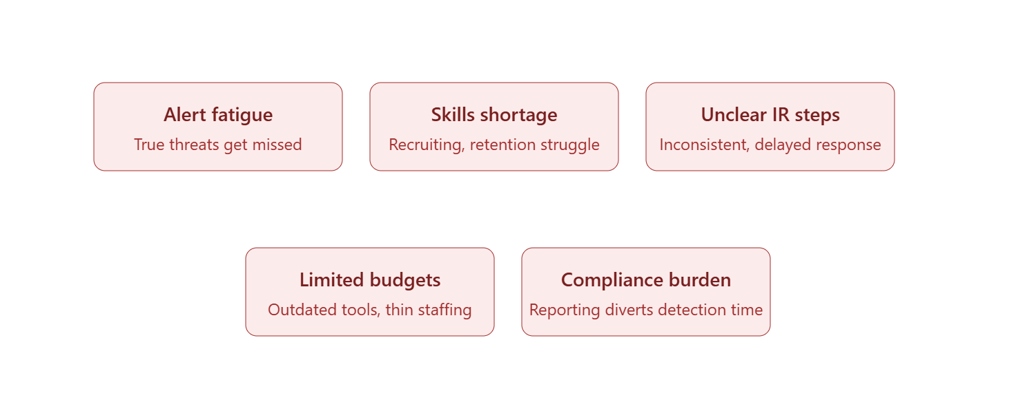
SOC Challenges

Slide 36
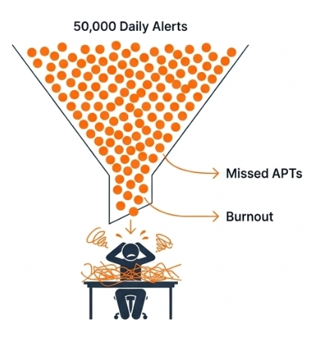
SOC Challenges
Too Many Alerts (Alert Fatigue)
  SOC analysts are often overwhelmed by the huge volume of alerts generated by SIEM, IDS/IPS, firewalls, and EDR tools.
  Many of these alerts are false positives or duplicates, making it difficult to identify true threats.
  Alert fatigue can lead to missed incidents, delayed responses, and analyst burnout.
  Example: A SIEM generates 50,000 alerts daily; analysts realistically can only investigate a fraction, leading to missed APT (Advanced Persistent Threat) activity.

Slide 37
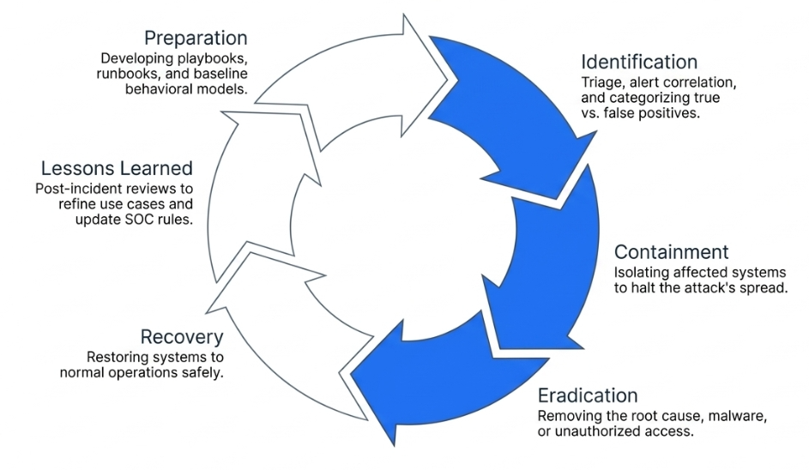
SOC Challenges
Lack of Clear Incident Response Procedures and Policies
  Without standardized playbooks and runbooks, responses to incidents can be inconsistent or delayed.
  Some SOCs operate in a reactive mode rather than following structured frameworks like NIST IR (PICERL) or SANS IR.
  This lack of clarity makes it hard to assign responsibilities and ensure proper evidence handling.
  Example: During a ransomware outbreak, delays in isolating infected machines occur because no clear containment procedure exists.

Slide 38
SOC Challenges
Limited Security Budgets
  Many SOCs operate under tight financial constraints.
  This leads to challenges such as:
    Inability to purchase advanced detection tools (e.g., SOAR, XDR).
    Limited investment in training and certifications for analysts.
    Shortage of skilled staff due to low salaries compared to market demand.
  Result: Organizations may rely on outdated technology, minimal automation, and smaller teams, leaving them vulnerable.
  Example: A SOC might rely solely on open-source tools, which while powerful, require significant expertise to manage effectively.

Slide 39
SOC Challenges
Compliance and Regulatory Requirements
  SOCs must ensure adherence to multiple regulations (e.g., GDPR, HIPAA, PCI DSS, ISO 27001).
  Compliance requires:
    Proper logging and reporting.
    Data retention policies.
    Privacy controls.
  Meeting compliance often diverts resources from active threat detection to documentation and reporting.
  Example: A SOC team spends more time generating compliance audit reports than improving detection rules or conducting proactive threat hunting.

Slide 40
SOC Challenges
Security Skills Shortage
  There’s a global shortage of skilled cybersecurity professionals, particularly in SOC roles.
  SOC teams need expertise in incident response, threat hunting, malware analysis, and forensics—but many organizations struggle to recruit or retain talent.
  This leads to longer detection and response times and reliance on junior staff with limited experience.
  Example: A Tier 1 SOC analyst may escalate too many false positives to Tier 2 due to lack of expertise, increasing workload inefficiency.

Slide 41
References
[1] G. Jarpey and R. S. McCoy, Security Operations Center Guidebook: A Practical Guide for a Successful SOC, n.d.
[2] "Understanding SOC, its components, setup, and benefits," Spiceworks.
[3] "What is a SOC: Functions, roles, benefits, challenges," AKATI Security.
[4] M. Riley, B. Elgin, D. Lawrence, and C. Matlack, "Missed alarms and 40 million stolen credit card numbers: How Target blew it," Bloomberg Businessweek, Mar. 13, 2014. [Online]. Available: http://www.businessweek.com/articles/2014-03-13/target-missed-alarms-in-epic-hack-of-credit-card-data
[5] B. Krebs, "Sources: Target investigating data breach," KrebsOnSecurity, Dec. 18, 2013. [Online]. Available: https://krebsonsecurity.com/2013/12/sources-target-investigating-data-breach/
[6] "The role of security operations centers in incident detection and response," MoldStud.
[7] "Equifax says unpatched Apache Struts flaw behind massive security breach," Data Center Knowledge. [Online]. Available: https://www.datacenterknowledge.com/data-breaches/equifax-says-unpatched-apache-struts-flaw-behind-massive-security-breach
[8] "Congressional report rips Equifax for weak security," BankInfoSecurity. [Online]. Available: https://www.bankinfosecurity.com/congressional-report-rips-equifax-for-weak-security-a-12355

